Slide 1
Student Life-Cycle - Oversight and Analysis
Ashish Gupta

Slide 2
Problem Statement
Envision, design and build a reliable enterprise level analytical eco-system to support organization’s analytical needs to manage student life cycle.

Slide 3
Proposed & Built Solution
An analytical data platform to support all strategical and tactical reporting needs.
Foundation was an enterprise data warehouse comprising of subject-area (life-cycle phase) based data marts using federated model approach.
Significant structure - Student Life Cycle Fact table (Grain: Student)
Captured relevant KPIs/metrics from all phases of student life-cycle
along with conformed dimensions.

Slide 4
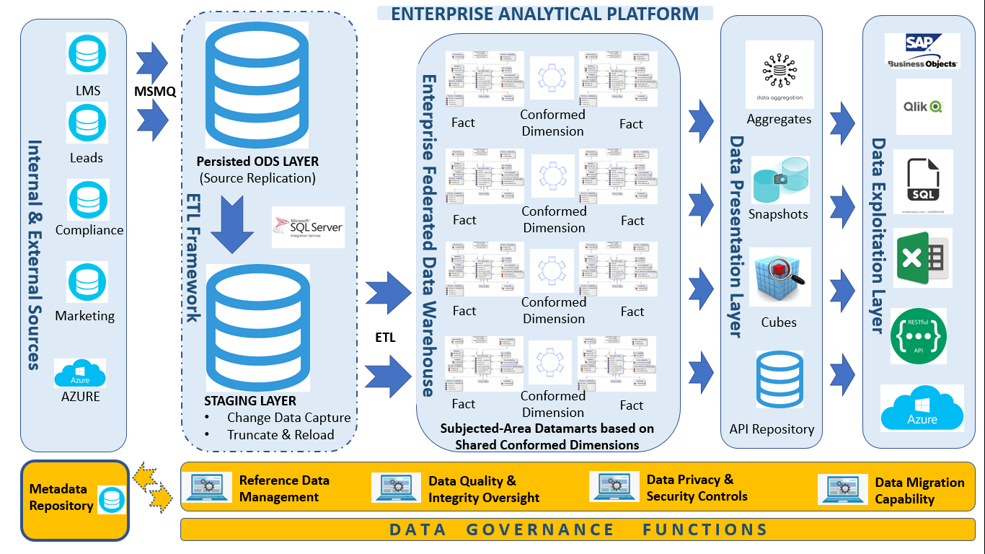
Analytical Platform Architecture

Slide 5
Analytical Structure - Key Features
Structure
Denormalized Fact Structure
Lowest Grain – Student
All metrics – quantifiable, Could be aggregated on any dimensional lines
Supported point-in-time analysis
https://drive.google.com/file/d/1rGiS0jzGMmIP2AEU7nU8vA5OBlh6s6fS/view?usp=sharing
Uniqueness
Fact Structure was 1 stop-shop for generating any KPI/metrics requested.
Integration
Data flowed in from system-of-record source systems into staging area.

Slide 6
Analytical Structure - Key Features
Quality
DQ checks performed in all load stages: Extract → Load → Transform → Exploit.
A Central, Automated & Abstract Platform Engine was used in every load phase to check the data quality in pro-active and reactive mode.
Access
Well-defined security regime (authentication & authorization) was established using database features.
Similar approach was taken across all data exploitation channels and
platforms (Reporting Apps, Dashboards and Visualization Tools)

Slide 7
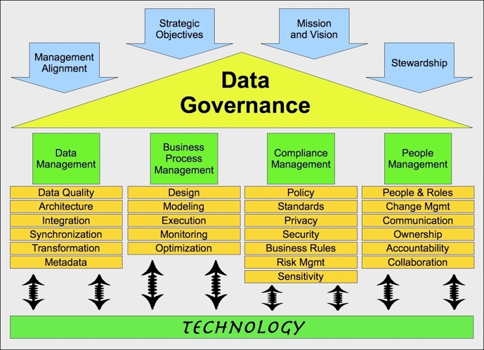
Analytical Structure - Key Features
Privacy
Attribute level access security implemented for PII and sensitive variables.
Encryption applied on PII and sensitive variables.
Governance

Slide 8
THANK YOU / Q&A

